Slide 1
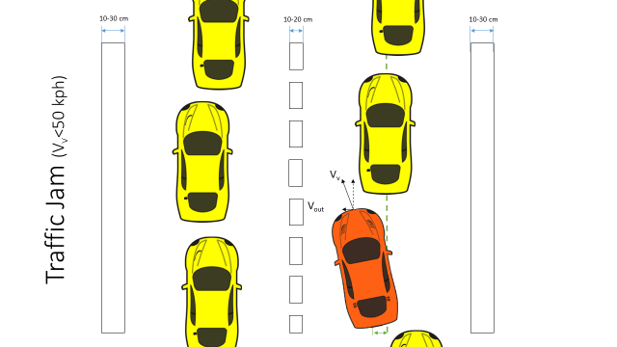
LKA Functional Safety Draft Presentation
Davide Occello, January 6th 2017

Slide 2

Content
Introduction
Project Timeline
Euro NCAP Requirements
Functional Safety Concept (ISO 26262)
Item Definition
Safety Relevant Use Cases
HARA & Safety Goals
Functional Architecture
Functional Safety Requirements
Improved Architecture (Draft)
Deliverables

Slide 3
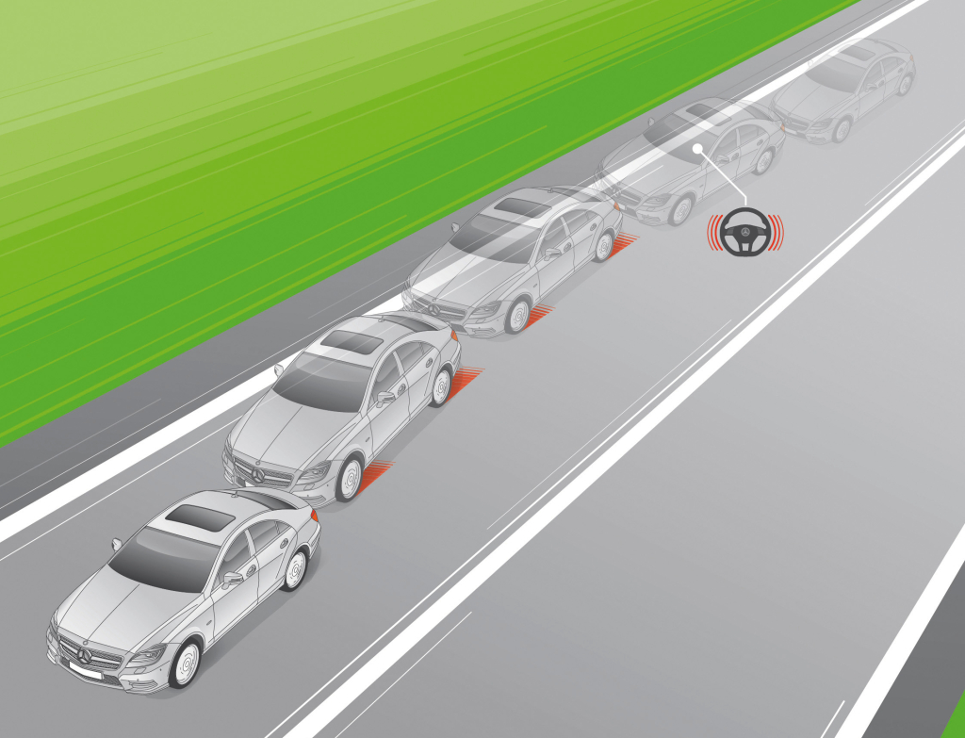
Introduction
Why Active Lane Keeping Assist
The system aims to avoid dangerous situations like the following:
Driver distraction →Late realisation of danger → panic response→loss of control →crash
Approach to avoid the scenario
Support the driver by actively steering towards the center of the lane and warn him in advance if the car is going to close to the edge

Slide 4
Project Timeline
Phase 1: Functional Safety
Phase 2:
Design
23 days
Phase 3: Implementation
25/11/16 – 13/01/17
26 days
12 days
43 days
55 days
2016
Nov
Dec
Jan
Feb
Mar
2017
Today
25.11.16
13.01.17
16.01.17
27.01.17
30.01.17
28.03.17
Project Kick Off
Project End

Slide 5
Project Timeline (Phase 1)
Phase 1:
Functional Safety
25/11/16 – 13/01/17
26 days
NCAP Requirements
2nd Dec
Documentation
12th Jan
CAFCR
9th Dec
HARA
14th Dec
FSR
20th Dec
2016
Nov
Today
Dec
Holidays
Jan
2017
25.11.16
13.01.17
End – Phase 1
Project Kick Off

Slide 6
EURO NCAP Requirements
This protocol specifies the Lateral Support Systems test procedure
Mainly information about the test conditions
Some Information on the other systems that are required in combination with the LKA
Suggestions on the operation of the system

Slide 7
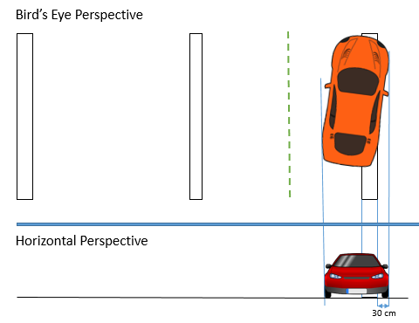
EURO NCAP Requirements
Examples from the document:
Test conditions: LKA should detect unintentional lane change at least, when the outside of the tire closest to the outside of the lane markings crosses 0.3 m or beyond.
System functionality: LKA shall use the lateral support system to restore control of the vehicle while countering the unintentional lane change.
Required Additional Systems: LKA system shall be available only if vehicle possess Electronic Stability Control system in compliance with regulatory requirements.

Slide 8
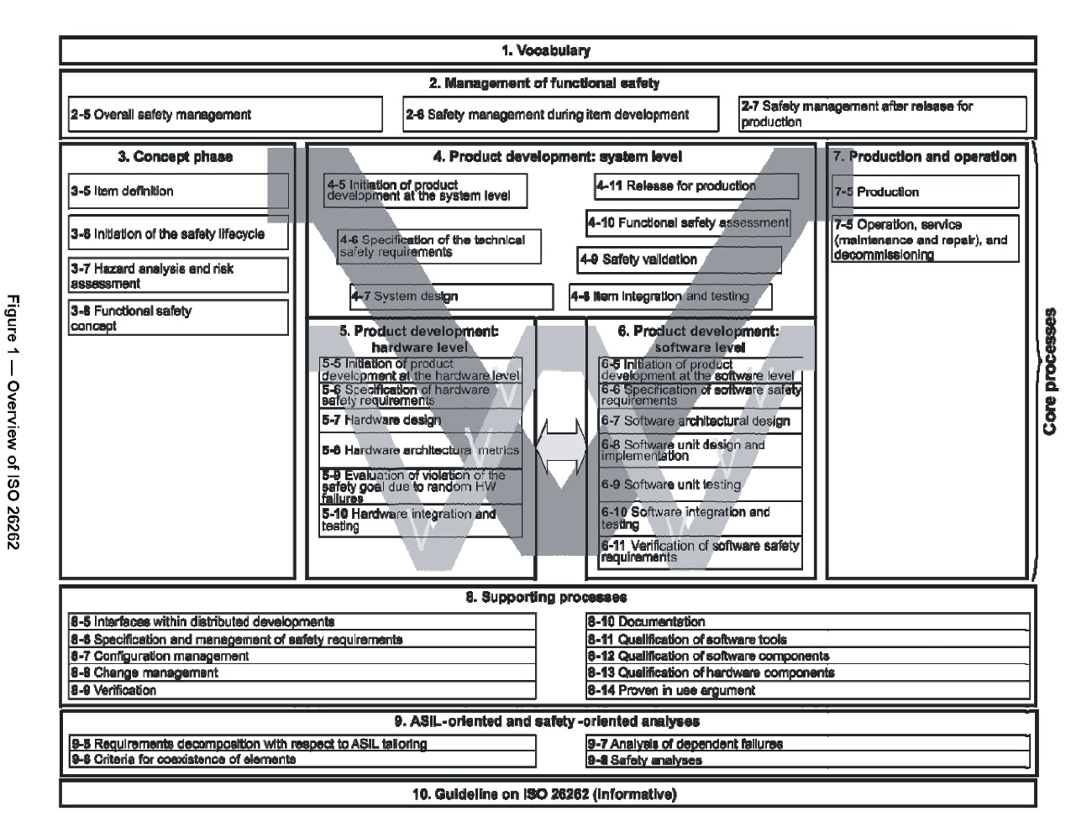
Functional Safety Concept (ISO 26262)
Phase 1 of the project:
Item definition
HARA
FSC

Slide 9
Item Definition
The main system function of a ‘Lane Keeping Assistance System (LKAS)’ is:
detect the unintentional drift outside the lane on which it is travelling
to support the driver in keeping the vehicle within the current lane
the responsibility for the safe operation of the vehicle always remains with the driver.
Approach to Functional Safety
Warn the Driver and deactivate LKA when failures occur
Add redundancy for very important functionalities

Slide 10
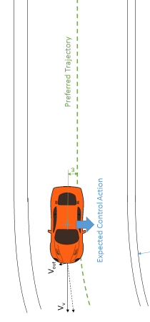
Scenarios
Visual Representation
Safety Relevant Use Cases
Target Environment: Highway*
Vehicle Speed
V_{v}= 50 -130 kph (normal operating conditions)
Lateral vehicle acceleration < 0.3 g
Lane markings according to the EU road network legislation
* Information derived from EURO NCAP requirement document

Slide 11



Straight Lane /
10-30 cm
10-20 cm
3.5-3.7 m
10-30 cm
V_{v}
R >1000 m
V_{out}
Expected Control Action
ε

Slide 12
Curve /
V_{out}
V_{v}
ε
Preferred Trajectory
Expected Control Action
R >250 m

Slide 13
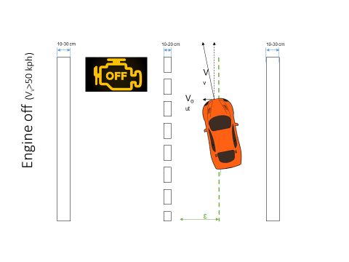
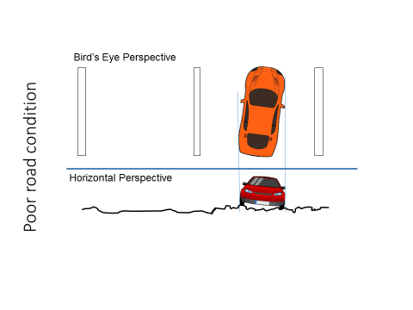
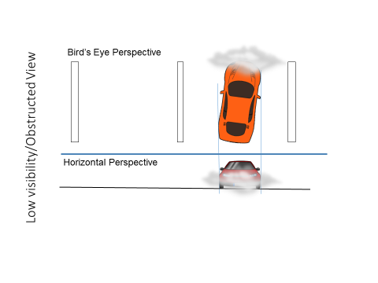
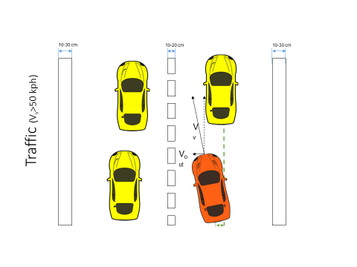

Slide 14


Traffic Jam (V_{v}<50 kph)
10-30 cm
10-20 cm
10-30 cm
V_{v}
V_{out}
ε

Slide 15
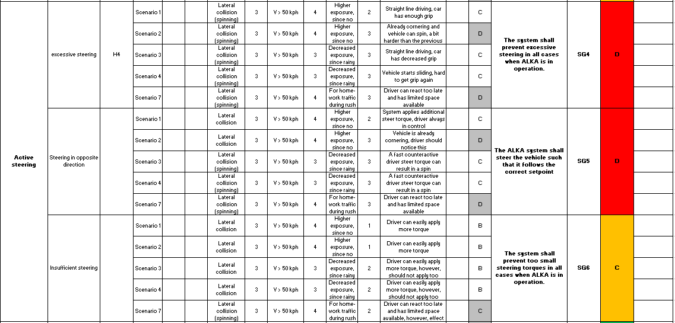
Hazard and Risk Analysis

Slide 16
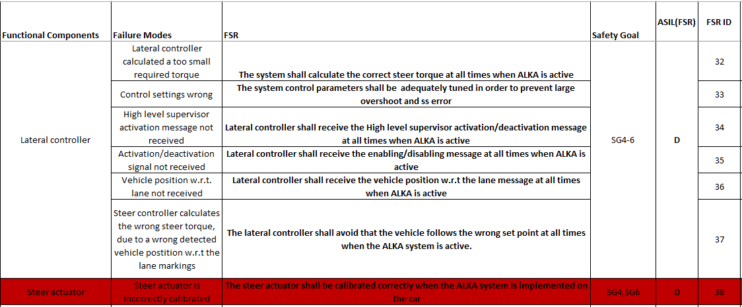
Hazard and Risk Analysis

Slide 17
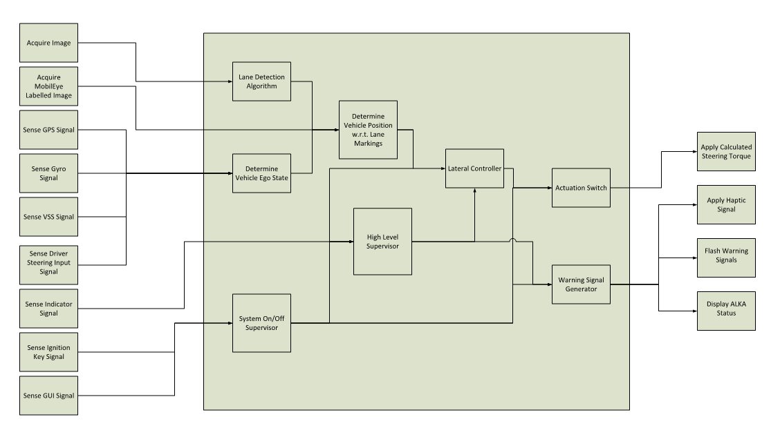
Functional Architecture

Slide 18
Functional Architecture

Slide 19
Functional Architecture
Highly safety critical
ASIL D

Slide 20
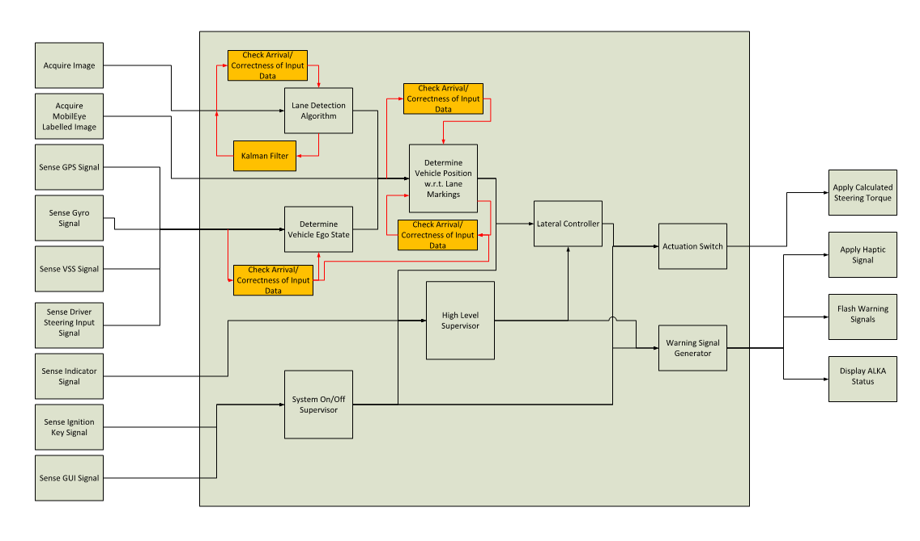
Improved Architecture
Safety Measures
ASIL A (D)
ASIL D
ASIL C (D)
ASIL A (D)
ASIL D
ASIL B (D)
ASIL A (D)
ASIL D
ASIL C (D)
ASIL A (D)
ASIL C (D)

Slide 21
Improved Architecture (Unfinished)
ASIL C

Slide 22
Questions
?

